Slide 1
A FLEXIBLE EMAIL CLIENT APP
Mariyappan M

Slide 2
OBJECTIVES
The email client app aims to provide a simple and efficient way to manage emails from multiple accounts. It focuses on an easy-to-use design, secure communication with features like encryption, and tools to boost productivity, such as smart email sorting and calendar integration. The app also offers offline access, customizable settings, and AI-powered features to prioritize important emails and block spam, making email management seamless and reliable for all users
Enhanced User Experience : Create a user-friendly interface for seamless email management.
Flexibility : Support multiple email providers (e.g., Gmail, Yahoo, Outlook) with ease of configuration.
Security : Provide robust security features to protect user data and privacy.
Efficiency : Optimize for quick email retrieval, sending, and searching.
Customization : Allow users to personalize their email experience through themes, layouts, and notification settings

Slide 3
DESCRIPTION
The flexible email client app is designed to make managing emails easy and efficient. It allows users to connect multiple email accounts, like Gmail, Yahoo, and Outlook, and view all their emails in one place. The app includes useful features such as advanced search to quickly find emails, offline access to read and draft emails without the internet, and smart tools to automatically organize emails into categories like Primary, Social, and Promotions.
Overview : This project focuses on developing an innovative and flexible email client application to streamline email management.
Target Users : Designed for professionals, students, and general users requiring a reliable email solution.
Platform Compatibility : Available for Android, iOS, and desktop platforms.

Slide 4
FUNCTIONALITIES
The email client app simplifies email management with features like multi-account support to view all emails in one inbox, advanced search, and offline access. It organizes emails into categories, supports rich text formatting, and integrates with calendars for easy event management. With spam filtering and the ability to attach files from cloud storage, the app ensures a smooth and efficient email experience.
Multi-Account Support : Manage emails from multiple accounts like Gmail, Yahoo, and Outlook in one app.
Unified Inbox : View all emails from different accounts in a single, organized inbox.
Search Emails : Quickly find emails using keywords, sender names, or date filters.
Spam Filtering : Detect and block spam emails to keep the inbox clean.

Slide 5
ADDITIONAL
REQUIREMENTS
Security Features :
End-to-end encryption for sensitive emails.Two-factor authentication for login.
Cloud Storage Integration :
Attach files directly from cloud platforms like Google Drive or Dropbox.
Accessibility :
Support for screen readers and adaptive themes for visually impaired users.
Analytics Dashboard :
Track email activity, response times, and usage trends.
AI-Powered Insights :
Suggest responses, detect spam, and prioritize emails using AI.
Cross-Platform Sync :
Ensure a seamless experience across devices.

Slide 6
Main Activity.java:
package com.example.emailapplication import android.content.Context import android.content.Intent import android.os.Bundle import androidx.activity.ComponentActivity import androidx.activity.compose.setContent import androidx.compose.foundation.Image import androidx.compose.foundation.background import androidx.compose.foundation.layout.* import androidx.compose.material.* import androidx.compose.runtime.Composable import androidx.compose.ui.Alignment import androidx.compose.ui.Modifier import androidx.compose.ui.graphics.Color import androidx.compose.ui.layout.ContentScale import androidx.compose.ui.res.painterResource import androidx.compose.ui.text.font.FontWeight import androidx.compose.ui.tooling.preview.Preview import androidx.compose.ui.unit.dp import androidx.compose.ui.unit.sp

Slide 7
import androidx.core.content.ContextCompat import androidx.core.content.ContextCompat.startActivity import com.example.emailapplication.ui.theme.EmailApplicationTheme class MainActivity : ComponentActivity() { override fun onCreate(savedInstanceState: Bundle?) { super.onCreate(savedInstanceState) setContent { // A surface container using the 'background' color from the theme Surface( modifier = Modifier.fillMaxSize().background(Color.White), ) { Email(this) } } } }

Slide 8
@Composable fun Email(context: Context) { Text( text = "Home Screen", modifier = Modifier.padding(top = 74.dp, start = 100.dp, bottom = 24.dp), color = Color.Black, fontWeight = FontWeight.Bold, fontSize = 32.sp ) Column( horizontalAlignment = Alignment.CenterHorizontally, verticalArrangement = Arrangement.Center ) { Image( painterResource(id = R.drawable.home_screen), contentDescription = "" ) Button(onClick = { context.startActivity( Intent( context, SendMailActivity::class.java

Slide 9
) ) }, colors = ButtonDefaults.buttonColors(backgroundColor = Color(0xFFadbef4)) ) { Text( text = "Send Email", modifier = Modifier.padding(10.dp), color = Color.Black, fontSize = 15.sp ) } Spacer(modifier = Modifier.height(20.dp)) Button(onClick = { context.startActivity( Intent( context, ViewMailActivity::class.java ) ) },

Slide 10
colors = ButtonDefaults.buttonColors(backgroundColor = Color(0xFFadbef4)) ) { Text( text = "View Emails", modifier = Modifier.padding(10.dp), color = Color.Black, fontSize = 15.sp ) } } }

Slide 11
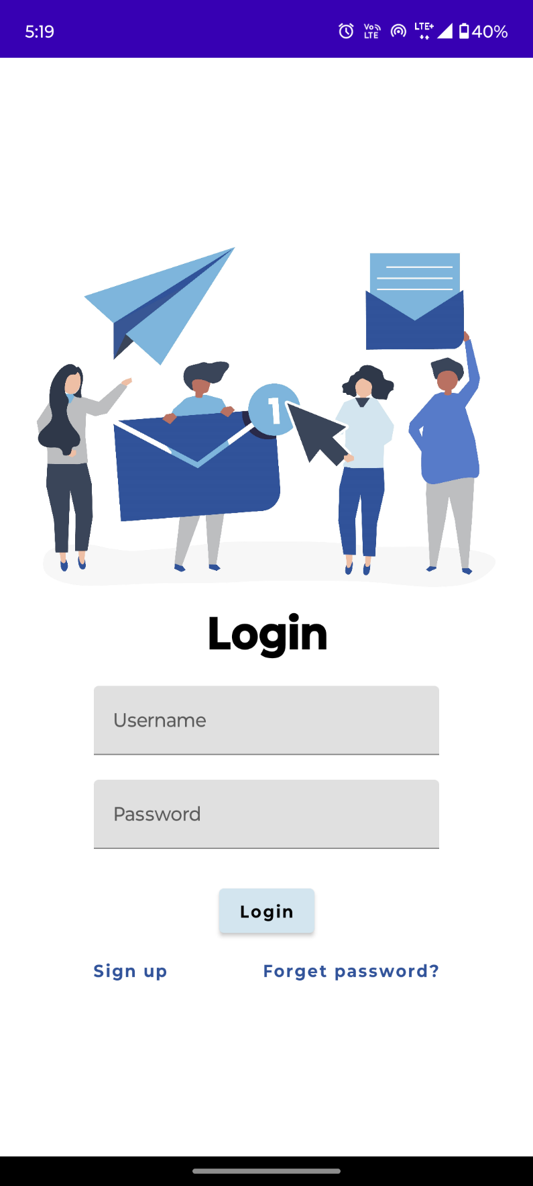
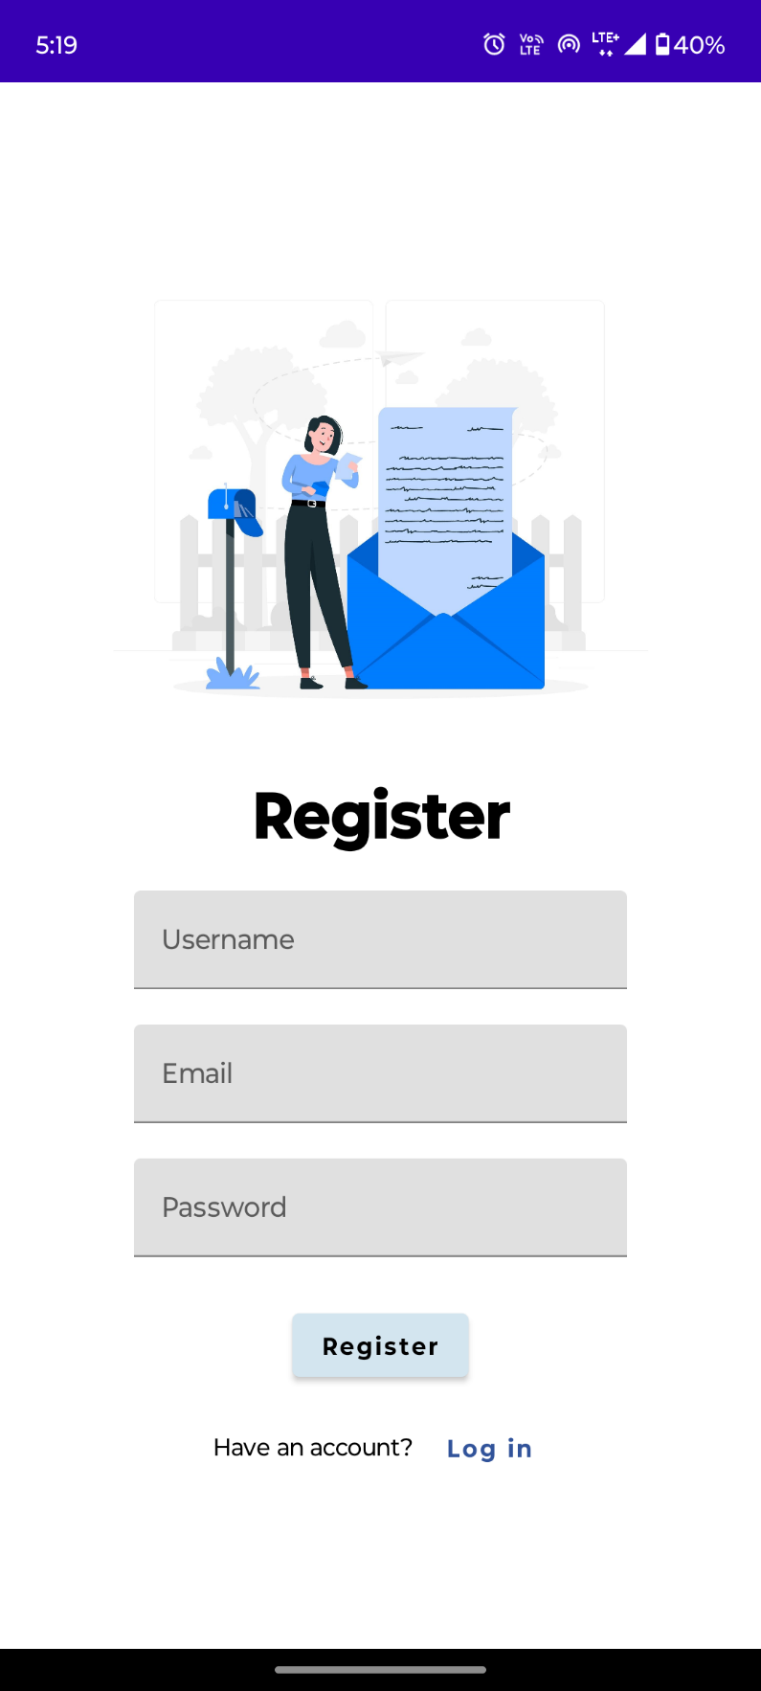
OUTPUT :

Slide 12
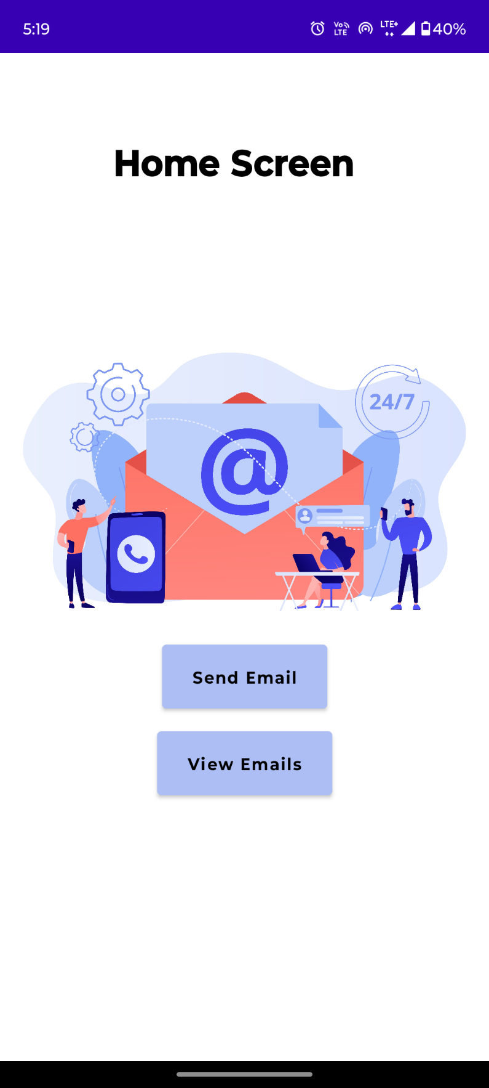

Slide 13
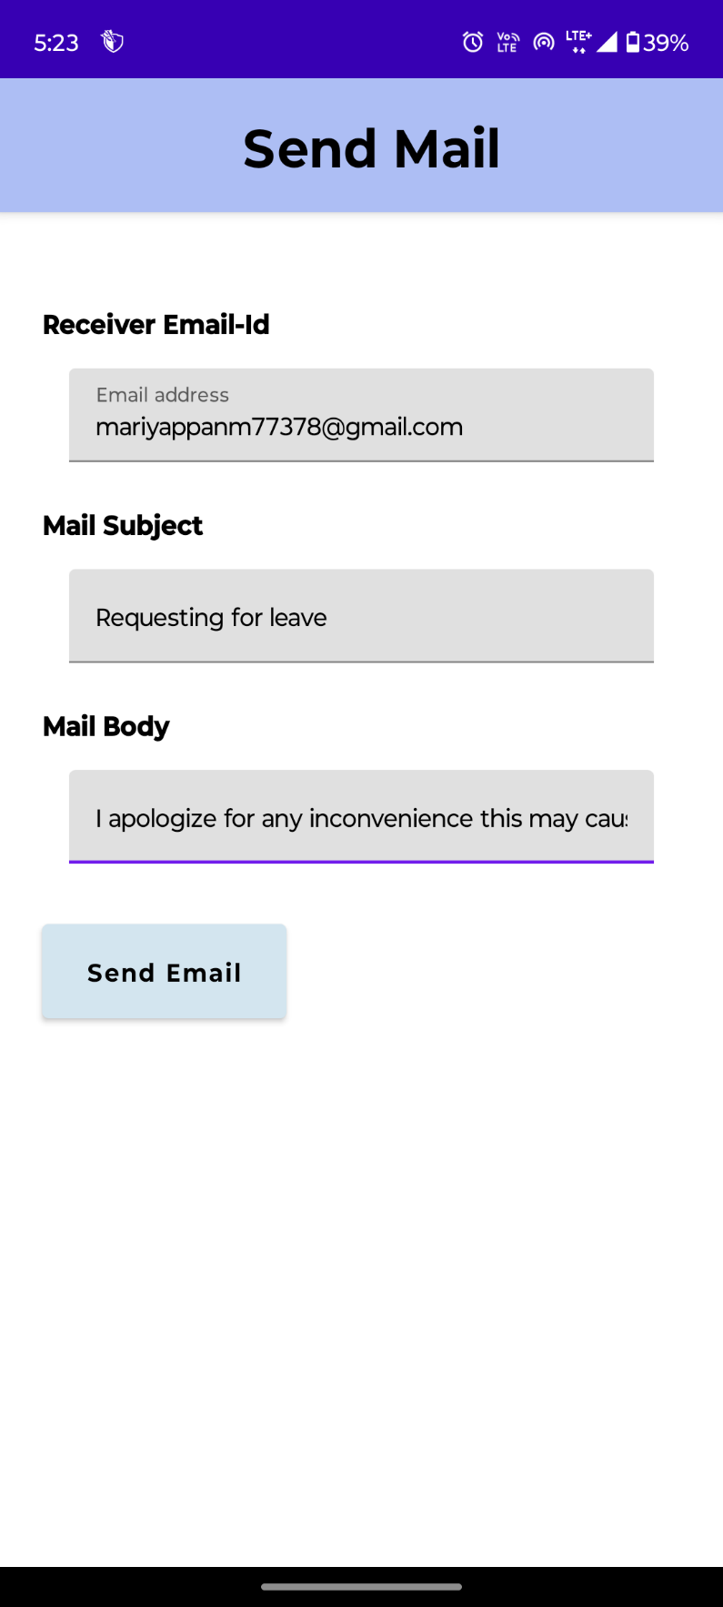
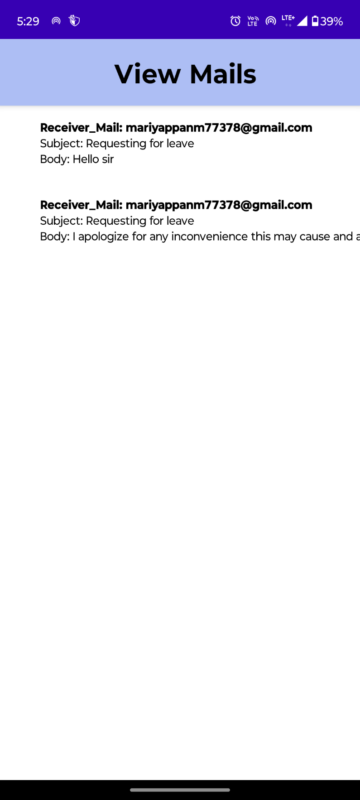

Slide 14
